Slide 1


K. RAMAKRISHNAN COLLEGE OF ENGINEERING
(AUTONOMOUS), SAMAYAPURAM - TRICHY DEPARTMENT OF CSE
CSC1342 – R PROGRAMMING AND DATA ANALYTICS
CALORIES BURNT PREDICTION
PRESENTED BY SUPERVISOR
K. KRISHKANTH Mr. P. KASTHURI RENGAN M.E.,
8115U23CS051 Assistant Professor / CSE

Slide 2
PRESENTATION OVERVIEW
Abstract
Introduction
Flowchart
Modules
Module with Explanation
Module with Inputs
Result
Visualization Page

Slide 3
ABSTRACT
This project develops a calories burn prediction system using machine learning models - Linear Regression and Random Forest - trained on fitness-related data. The system predicts calories burnt based on user inputs like age, weight, heart rate, and activity duration, providing an interactive visualization dashboard.

Slide 4
INTRODUCTION
Accurately estimating calories burned during physical activities is crucial for personal fitness management and health monitoring. This project leverages data-driven modeling techniques to predict calories burned, helping users track exercise efficiency and make informed health choices.

Slide 5
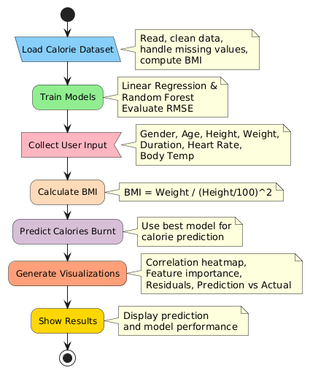
FLOWCHART

Slide 6
MODULES
Data Loading and Preprocessing
Model Training
User Input Collection
Prediction Computation
Visualization Generation
Result Reporting

Slide 7
MODULE 1 – DATA LOADING AND PREPROCESSING
Loads calorie dataset and removes missing values.
Converts categorical variables (e.g., Gender) to factors for analysis.
Engineers BMI feature combining weight and height for better modeling.
Prepares clean, structured data ready for machine learning.

Slide 8
MODULE 2 – MODEL TRAINING
Trains Linear Regression model to capture linear relationships in data.
Builds Random Forest ensemble to model complex, nonlinear patterns.
Evaluates both models using RMSE metric on a test dataset.
Selects best-performing model for use in predictions.

Slide 9
MODULE 3 – USER INPUT COLLECTION
Collects individual user fitness details via console inputs.
Inputs include age, gender, height, weight, activity duration, heart rate, temperature.
Personalizes predictions based on user's current biometric data.

Slide 10
MODULE 4 – PREDICTION COMPUTATION
Calculates BMI from user inputs.
Applies trained models to estimate calories burnt based on input data.
Chooses prediction from best-performing model for accuracy.
Provides user-specific calorie burn estimate.

Slide 11
MODULE 5 – VISUALIZATION GENERATION
Creates correlation heatmap to show feature relationships.
Plots feature importance from Random Forest model.
Displays model comparison with RMSE values.
Shows residual distribution for error analysis.
Plots Actual vs Predicted values for model validation.

Slide 12
MODULE 6 – RESULT REPORTING
Presents selected model used for prediction.
Displays predicted calories burnt with user data.
Saves and shows all visualizations for performance insights.
Summarizes model reliability and prediction accuracy.

Slide 13
MODULES INPUTS
Gender : Male or Female (categorical)
Age : 10 to 90 years
Height : 100 cm to 220 cm
Weight : 30 kg to 150 kg
Duration : 1 to 300 minutes (exercise/activity time)
Heart Rate : 40 to 200 beats per minute
Body Temperature : 35 to 42 °C

Slide 14
RESULT
The project accurately predicts calories burnt using trained Linear Regression and Random Forest models based on user inputs, providing personalized and reliable calorie estimates. Visualizations confirm the model's performance and key influencing factors.

Slide 15
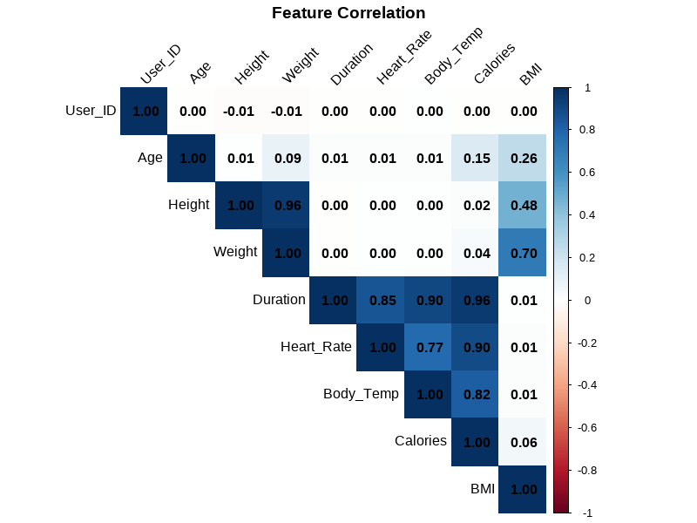
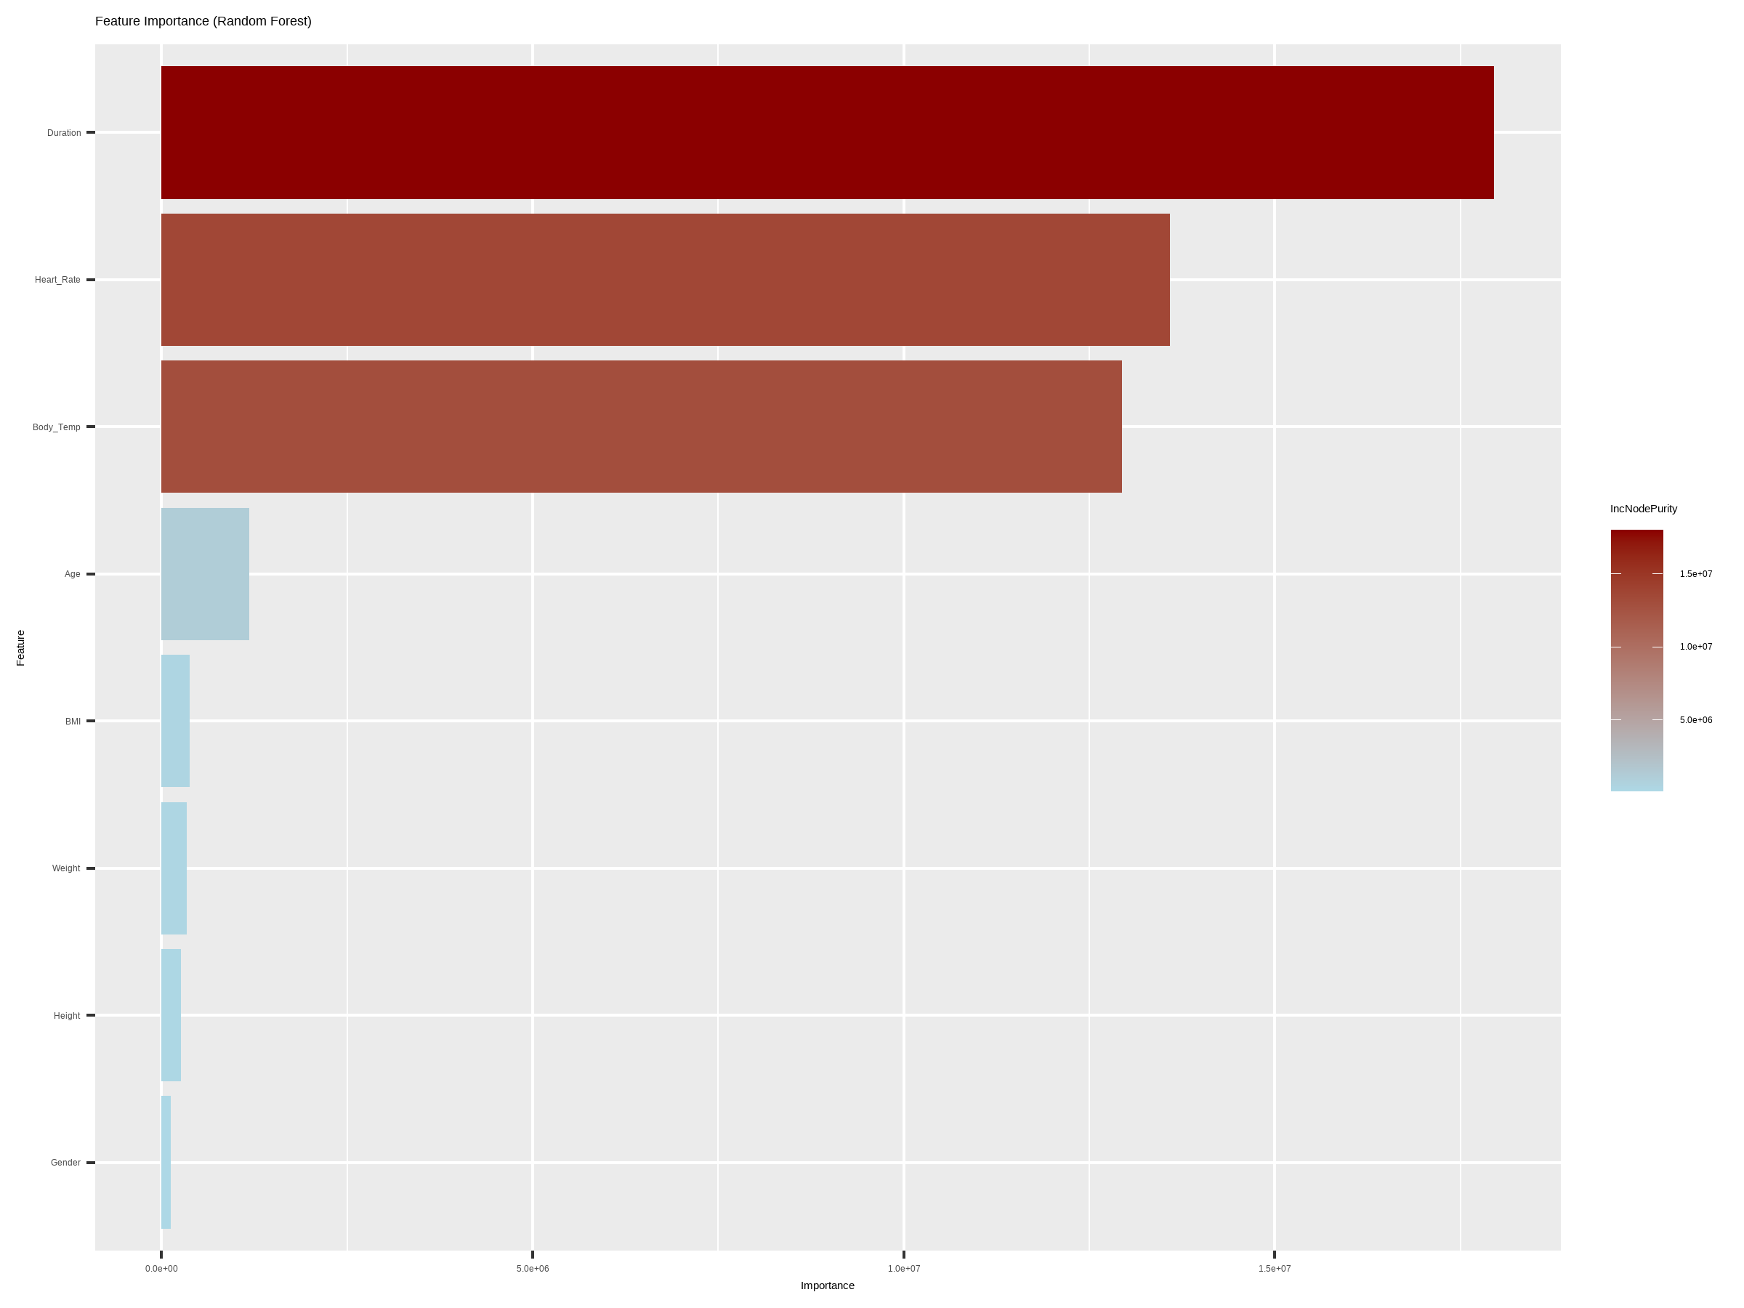
VISUALIZATION
CORRELATION HEAT MAP FEATURE IMPORTANCE

Slide 16
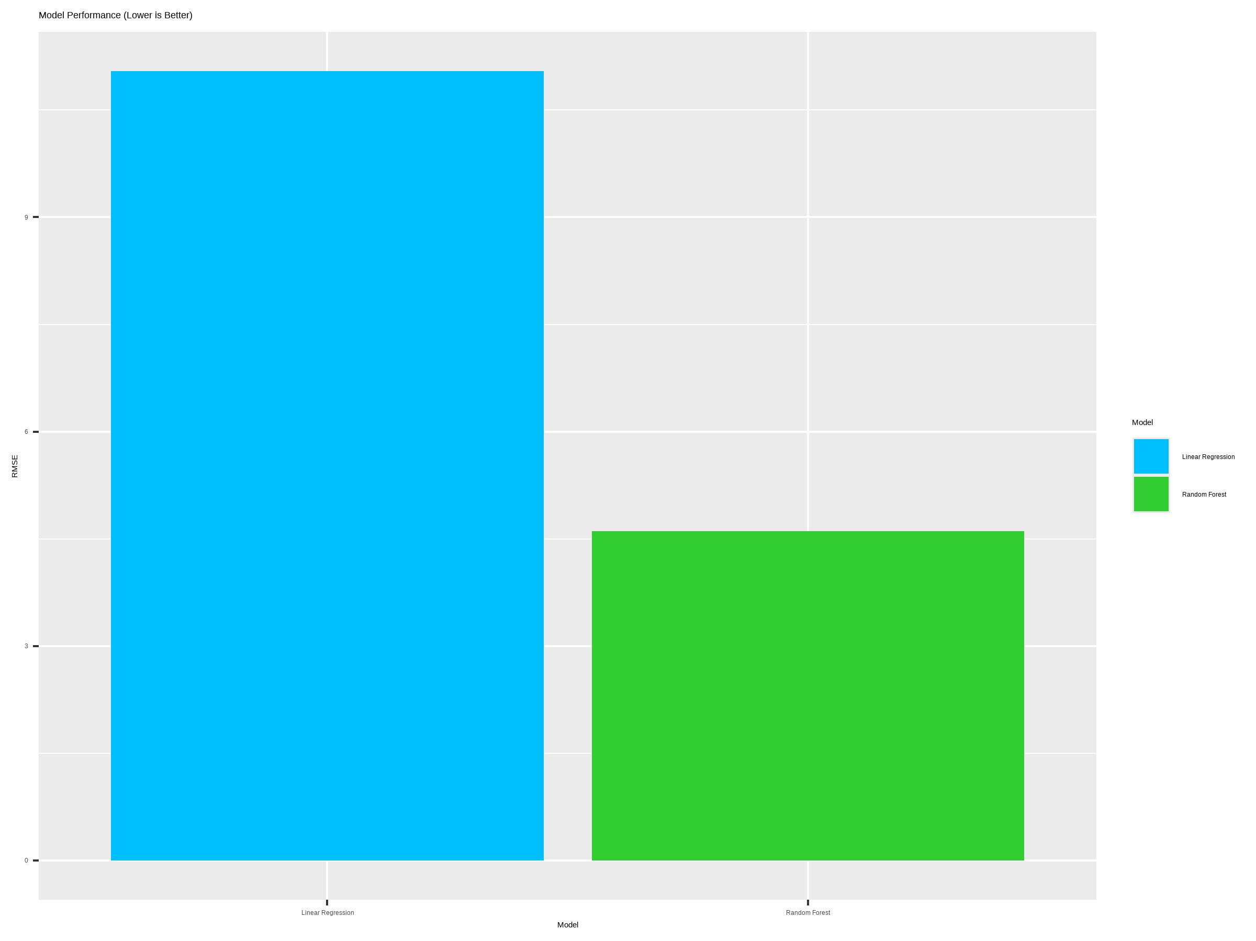
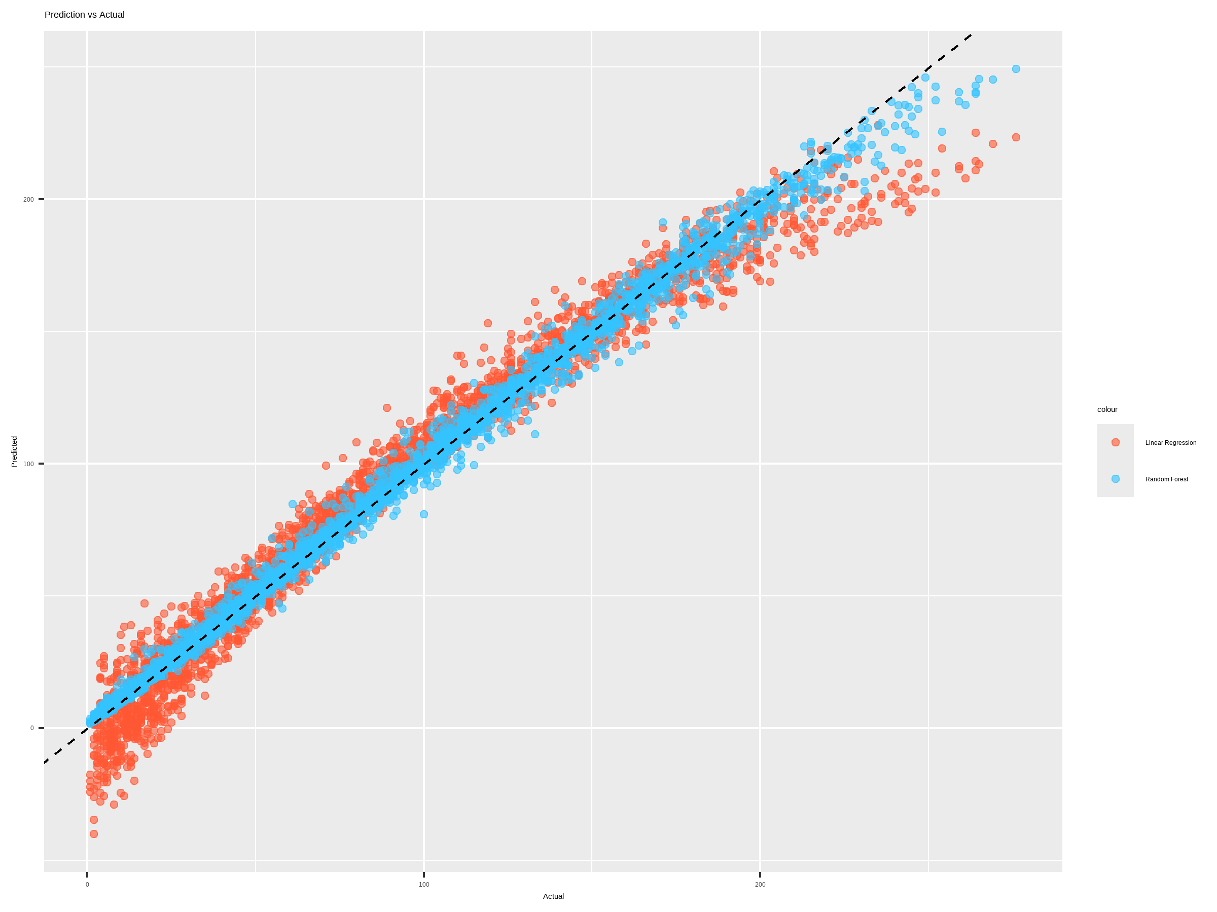
VISUALIZATION
MODEL COMPARISON PREDICTION VS ACTUAL

Slide 17
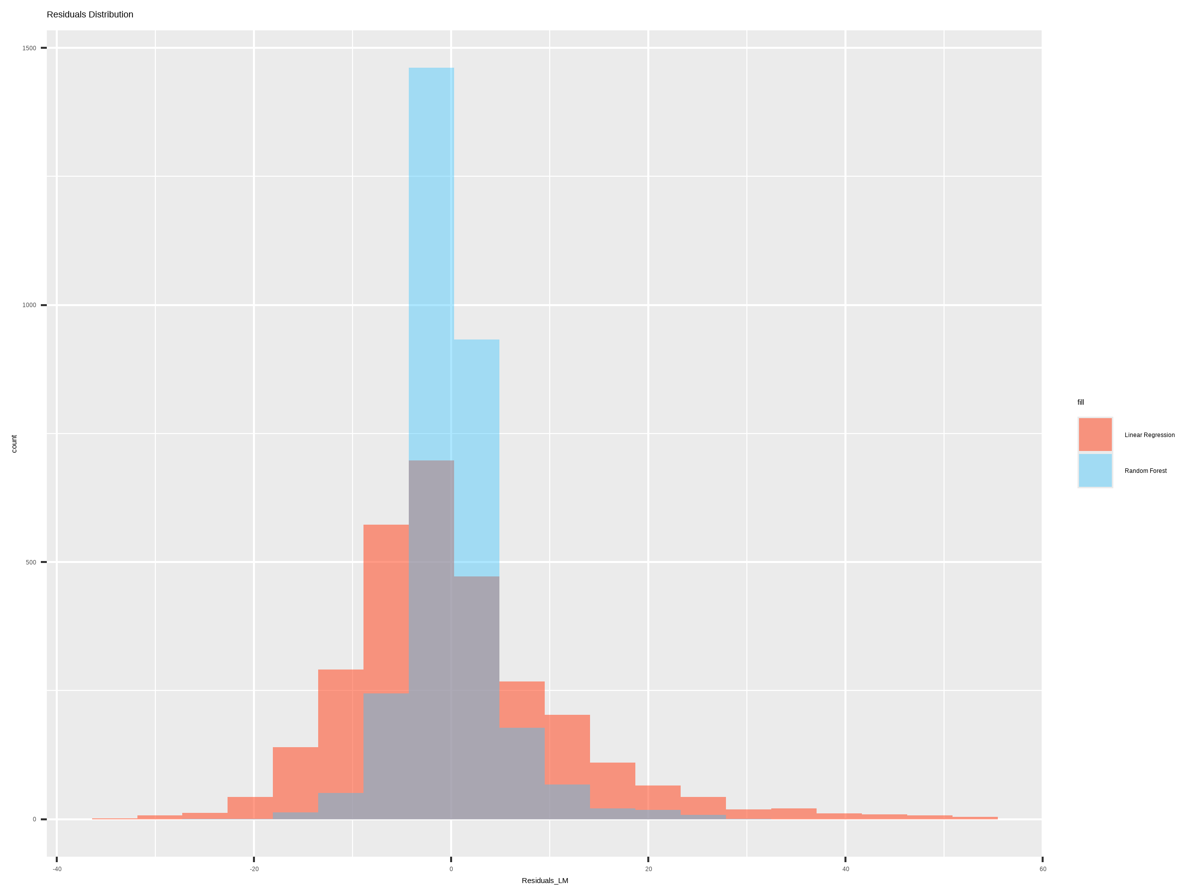
VISUALIZATION
RESIDUAL DISTRIBUTION

Slide 18
REFERENCES
Max Kuhn and Kjell Johnson. Applied Predictive Modeling, Springer, 2013.
R Core Team. R: A Language and Environment for Statistical Computing, R Foundation for Statistical Computing, Vienna, Austria, 2024. https://www.r-project.org/
Random Forest Tutorial - https://www.stat.berkeley.edu/~breiman/RandomForests/cc_home.htm
caret Package Documentation - https://topepo.github.io/caret/
corrplot Package Reference - https://cran.r-project.org/web/packages/corrplot/index.html

Slide 19


